Slide 1
Selection Statements
Java supports two selection statements: if and switch.
These statements allow you to control the flow of your program’s execution based upon conditions known only during run time.

Slide 2
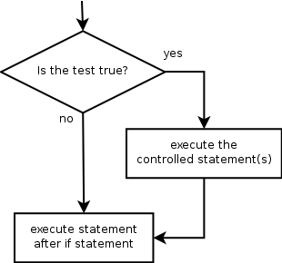
If Statement
Executes a block of statements only if a test is true
if (test) {
statement;
...
statement;
}
Example:
double gpa = console.nextDouble();
if (gpa >= 2.0) {
System.out.println("Application accepted.");
}

Slide 3
The if/else statement
Executes one block if a test is true, another if false
if (test) {
statement(s);
} else {
statement(s);
}
Example:
double gpa = console.nextDouble();
if (gpa >= 2.0) {
System.out.println("Welcome to Mars University!");
} else {
System.out.println("Application denied.");
}

Slide 4
Nested if/else
A nested if is an if statement that is the target of another if or else.
When you nest ifs, the main thing to remember is that an else statement always refers to the nearest if statement that is within the same

Slide 5
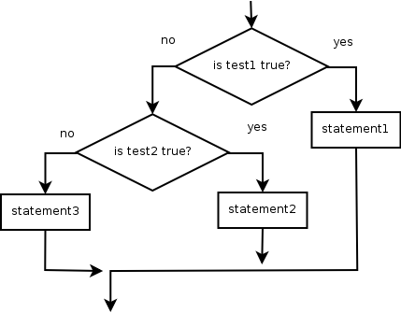
Example
Chooses between outcomes using many tests
if (test) {
statement(s);
} else if (test) {
statement(s);
} else {
statement(s);
}
Example:
if (number > 0) {
System.out.println("Positive");
} else if (number < 0) {
System.out.println("Negative");
} else {
System.out.println("Zero");
}

Slide 6
Nested if/else/if
If it ends with else, one code path must be taken.
If it ends with if, the program might not execute any path.
if (test) {
statement(s);
} else if (test) {
statement(s);
} else if (test) {
statement(s);
}
Example:
if (place == 1) {
System.out.println("You win the gold medal!");
} else if (place == 2) {
System.out.println("You win a silver medal!");
} else if (place == 3) {
System.out.println("You earned a bronze medal.");
}

Slide 7
Iteration Statements
Repetition statements allow us to execute a group of statements multiple times
Often they are referred to as loops
Like conditional statements, they are controlled by boolean expressions
Java has three kinds of repetition statements:
the while loop
the do loop
the for loop
The programmer should choose the right kind of loop for the situation

Slide 8
The while Statement
A while statement has the following syntax:
while ( condition )
statement;
If the condition is true, the statement is executed
Then the condition is evaluated again, and if it is still true, the statement is executed again
The statement is executed repeatedly until the condition becomes false

Slide 9
Logic of a while Loop
condition
evaluated
true
false
statement

Slide 10
The while Statement
An example of a while statement:
int count = 1;
while (count <= 5)
{
System.out.println (count);
count++;
}
If the condition of a while loop is false initially, the statement is never executed
Therefore, the body of a while loop will execute zero or more times

Slide 11
The while Repetition Structure
Flowchart of while loop
int product = 2;
while ( product <= 1000 )
product = 2 * product;
int product = 2
true
product <= 1000
product = 2 * product
false

Slide 12
Example--Parts of a while loop
int x = 1;
while (x < 10) {
System.out.println(x);
x++;
}
Label the following loop
int product = 2;
while ( product <= 1000 )
product = 2 * product;
Notes:
int x = 1; // initialization (set
// variables to initial
// values)
while (x < 10) { // test
System.out.println(x); // accumulation (do the
// work)
x++; // increment (advance the
// counter variable)
product is both the counter and accumulation variable

Slide 13
Nested Loops
Similar to nested if statements, loops can be nested as well
That is, the body of a loop can contain another loop
For each iteration of the outer loop, the inner loop iterates completely

Slide 14
Nested Loops
How many times will the string "Here" be printed?
count1 = 1;
while (count1 <= 10)
{
count2 = 1;
while (count2 <= 20)
{
System.out.println ("Here");
count2++;
}
count1++;
}

Slide 15
The do Statement
A do statement has the following syntax:
do
{
statement;
}
while ( condition )
The statement is executed once initially, and then the condition is evaluated
The statement is executed repeatedly until the condition becomes false

Slide 16
Logic of a do Loop
statement
true
condition
evaluated
false

Slide 17
The do Statement
An example of a do loop:
int count = 0;
do
{
count++;
System.out.println (count);
} while (count < 5);
The body of a do loop executes at least once

Slide 18
Comparing while and do
The while Loop
The do Loop
statement
condition
evaluated
true
false
condition
evaluated
true
statement
false

Slide 19
Choosing a Loop Statement
If you know how many times the loop will be iterated, use a for loop.
If you don’t know how many times the loop will be iterated, but
it could be zero, use a while loop
it will be at least once, use a do-while loop.
Generally, a while loop is a safe choice.

Slide 20
The for Statement
A for statement has the following syntax:
The initialization
is executed once
before the loop begins
The statement is
executed until the
condition becomes false
for ( initialization ; condition ; increment )
statement;
The increment portion is executed at the end of each iteration

Slide 21
Logic of a for loop
initialization
condition
evaluated
true
false
statement
increment

Slide 22
The for Statement
A for loop is functionally equivalent to the following while loop structure:
initialization;
while ( condition )
{
statement;
increment;
}

Slide 23
For Loop Example
class ForLoop
{
public static void main(String args[])
{
for(int i=1;i<=3;i++)
{ System.out.println(i); }
}
}
The output of the above code will be :-
1
2
3

